Slide 1
Computational Foundations for ML (10-607):
Dynamic Programming
Bryan Wilder
* Slides borrowed from prior offerings by Professors H. Heidari, M. Gormley, P. Virtue, & G. Gordon.

Slide 2
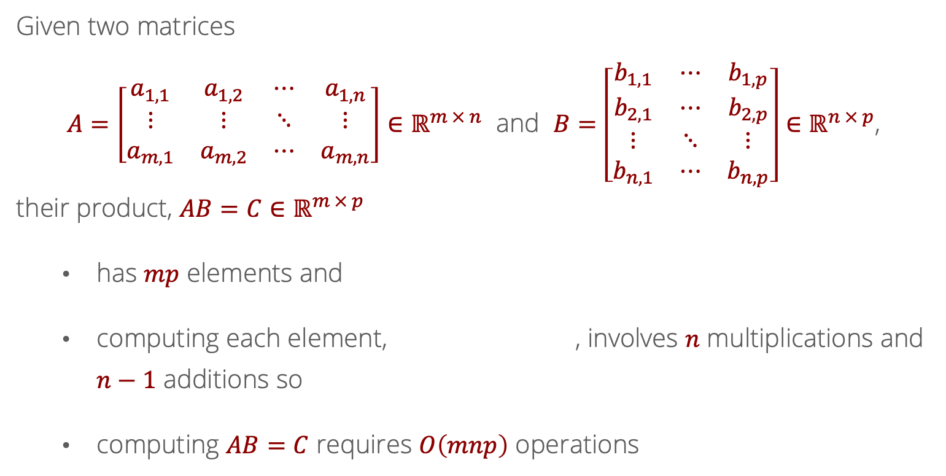
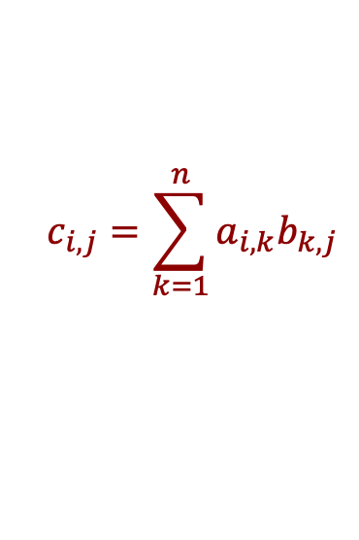
Recall: Computational cost of computing $AB$?
Given two matrices
$A=\left[\begin{matrix}a_{1,1} & a_{1,2} & ⋯ & a_{1,n} \\ ⋮ & ⋮ & ⋱ & ⋮ \\ a_{m,1} & a_{m,2} & ⋯ & a_{m,n}\end{matrix}\right]∈ℝ^{m × n}$ and $B=\left[\begin{matrix}b_{1,1} & ⋯ & b_{1,p} \\ b_{2,1} & ⋯ & b_{2,p} \\ ⋮ & ⋱ & ⋮ \\ b_{n,1} & ⋯ & b_{n,p}\end{matrix}\right]∈ℝ^{n × p}$,
their product, $AB=C∈ℝ^{m × p}$
has $mp$ elements and
computing each element, , involves $n$ multiplications and $n−1$ additions so
computing $AB=C$ requires $O\left(mnp\right)$ operations
$$c_{i,j}=\sum_{k=1}^{n}{a_{i,k}b_{k,j}}$$

Slide 3
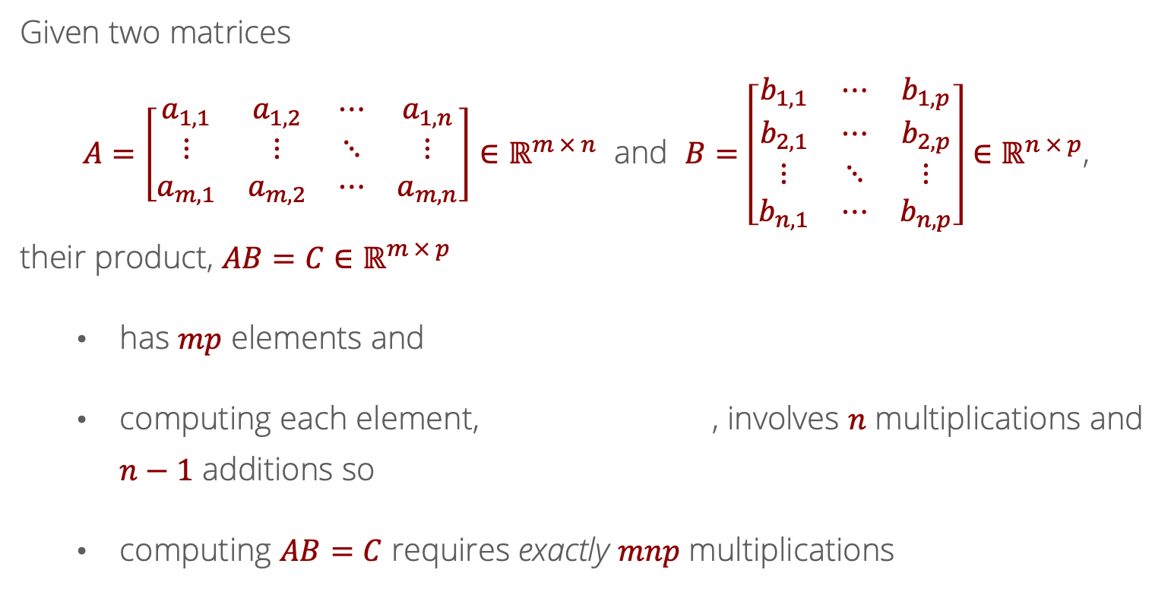
Recall: Computational cost of computing $AB$?
Given two matrices
$A=\left[\begin{matrix}a_{1,1} & a_{1,2} & ⋯ & a_{1,n} \\ ⋮ & ⋮ & ⋱ & ⋮ \\ a_{m,1} & a_{m,2} & ⋯ & a_{m,n}\end{matrix}\right]∈ℝ^{m × n}$ and $B=\left[\begin{matrix}b_{1,1} & ⋯ & b_{1,p} \\ b_{2,1} & ⋯ & b_{2,p} \\ ⋮ & ⋱ & ⋮ \\ b_{n,1} & ⋯ & b_{n,p}\end{matrix}\right]∈ℝ^{n × p}$,
their product, $AB=C∈ℝ^{m × p}$
has $mp$ elements and
computing each element, , involves $n$ multiplications and $n−1$ additions so
computing $AB=C$ requires exactly $mnp$ multiplications
$$c_{i,j}=\sum_{k=1}^{n}{a_{i,k}b_{k,j}}$$

Slide 4
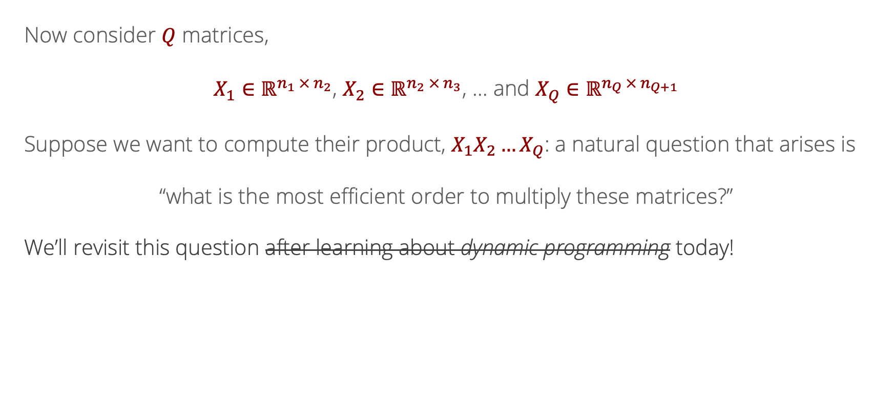
Likelihood
Recall: Multiple Matrix Multiplications
Now consider $Q$ matrices,
$X_{1}∈ℝ^{n_{1} × n_{2}}$, $X_{2}∈ℝ^{n_{2} × n_{3}}$, … and $X_{Q}∈ℝ^{n_{Q} × n_{Q+1}}$
Suppose we want to compute their product, $X_{1}X_{2}…X_{Q}$: a natural question that arises is
“what is the most efficient order to multiply these matrices?”
We’ll revisit this question after learning about dynamic programming today!

Slide 5
General Procedure for Dynamic Programming
Define the quantity of interest recursively
Specify the basis cases
Determine the inductive relationship
Construct a data structure (typically a matrix or an array) to hold solutions to subproblems
Working from the basis cases to the desired result, solve and store subproblems.

Slide 6
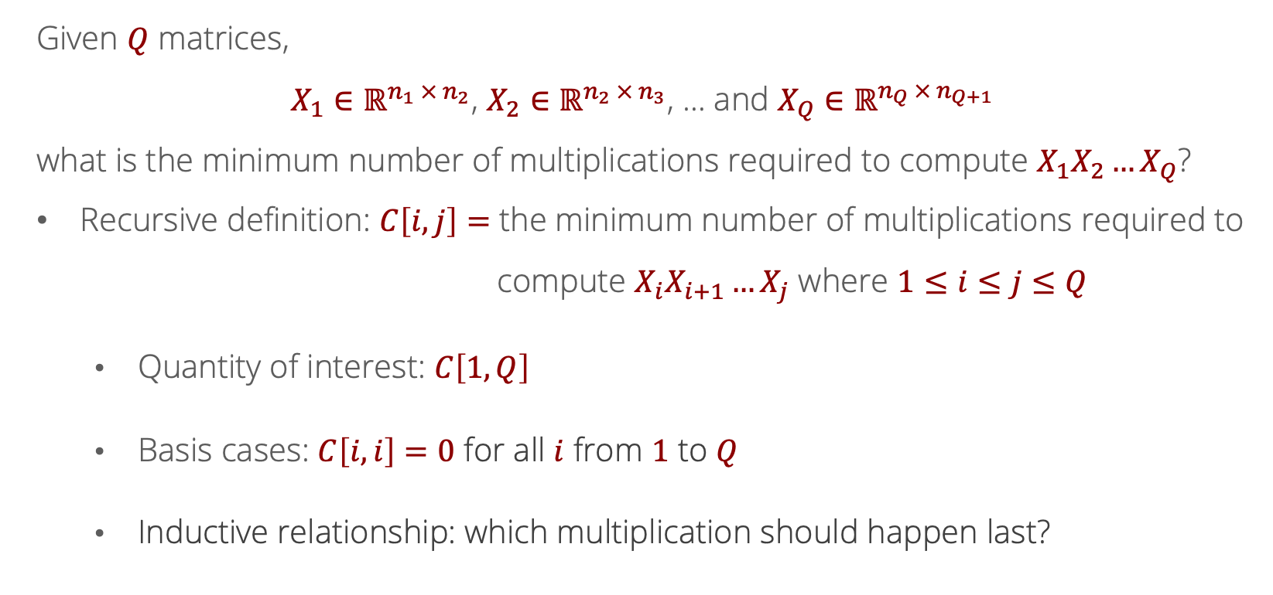
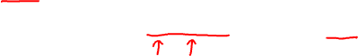
Recurrence Relation for Matrix Multiplication
Given $Q$ matrices,
$X_{1}∈ℝ^{n_{1} × n_{2}}$, $X_{2}∈ℝ^{n_{2} × n_{3}}$, … and $X_{Q}∈ℝ^{n_{Q} × n_{Q+1}}$
what is the minimum number of multiplications required to compute $X_{1}X_{2}…X_{Q}$?
Recursive definition: $C\left[i,j\right]=$ the minimum number of multiplications required to compute $X_{i}X_{i+1}…X_{j}$ where $1≤i≤j≤Q$
Quantity of interest: $C\left[1,Q\right]$
Basis cases: $C\left[i,i\right]=0$ for all $i$ from $1$ to $Q$
Inductive relationship: which multiplication should happen last?

Slide 7
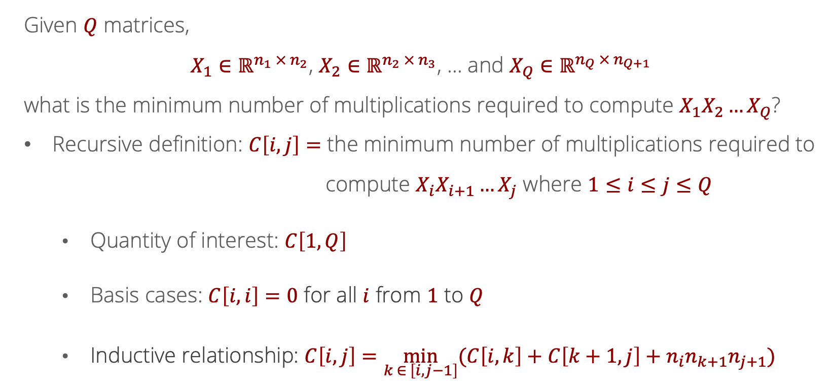
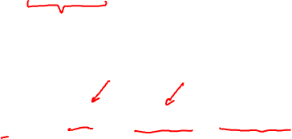
Recurrence Relation for Matrix Multiplication
Given $Q$ matrices,
$X_{1}∈ℝ^{n_{1} × n_{2}}$, $X_{2}∈ℝ^{n_{2} × n_{3}}$, … and $X_{Q}∈ℝ^{n_{Q} × n_{Q+1}}$
what is the minimum number of multiplications required to compute $X_{1}X_{2}…X_{Q}$?
Recursive definition: $C\left[i,j\right]=$ the minimum number of multiplications required to compute $X_{i}X_{i+1}…X_{j}$ where $1≤i≤j≤Q$
Quantity of interest: $C\left[1,Q\right]$
Basis cases: $C\left[i,i\right]=0$ for all $i$ from $1$ to $Q$
Inductive relationship: $C\left[i,j\right]=\min_{k ∈ \left[i,j−1\right]}{(C\left[i,k\right]+C\left[k+1,j\right]}+n_{i}n_{k+1}n_{j+1})$

Slide 8
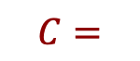
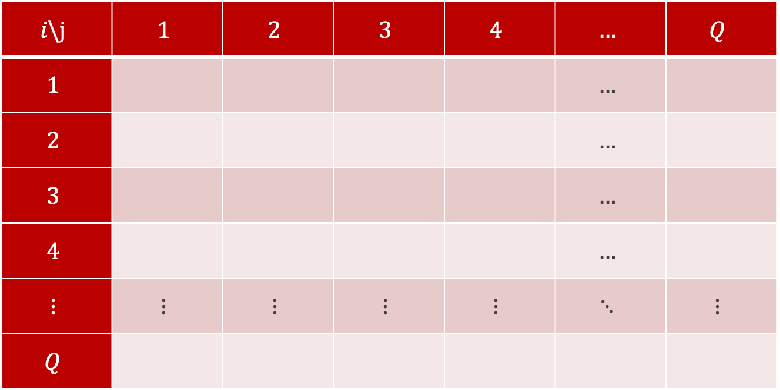
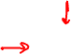
Defining a Data Structure
$$i\backslash j$$ | $$1$$ | $$2$$ | $$3$$ | $$4$$ | $$…$$ | $$Q$$
$$1$$ |  |  |  |  | $$…$$
$$2$$ |  |  |  |  | $$…$$
$$3$$ |  |  |  |  | $$…$$
$$4$$ |  |  |  |  | $$…$$
$$⋮$$ | $$⋮$$ | $$⋮$$ | $$⋮$$ | $$⋮$$ | $$⋱$$ | $$⋮$$
$$Q$$
$$C=$$

Slide 9

Defining a Data Structure
$$i\backslash j$$ | $$1$$ | $$2$$ | $$3$$ | $$4$$ | $$…$$ | $$Q$$
$$1$$ |  |  |  |  | $$…$$ | GOAL
$$2$$ |  |  |  |  | $$…$$
$$3$$ |  |  |  |  | $$…$$
$$4$$ |  |  |  |  | $$…$$
$$⋮$$ | $$⋮$$ | $$⋮$$ | $$⋮$$ | $$⋮$$ | $$⋱$$ | $$⋮$$
$$Q$$
$$C=$$

Slide 10

Defining a Data Structure
$$i\backslash j$$ | $$1$$ | $$2$$ | $$3$$ | $$4$$ | $$…$$ | $$Q$$
$$1$$ | $$0$$ |  |  |  | $$…$$ | GOAL
$$2$$ |  | $$0$$ |  |  | $$…$$
$$3$$ |  |  | $$0$$ |  | $$…$$
$$4$$ |  |  |  | $$0$$ | $$…$$
$$⋮$$ | $$⋮$$ | $$⋮$$ | $$⋮$$ | $$⋮$$ | $$⋱$$ | $$⋮$$
$$Q$$ |  |  |  |  |  | $$0$$
$$C=$$

Slide 11
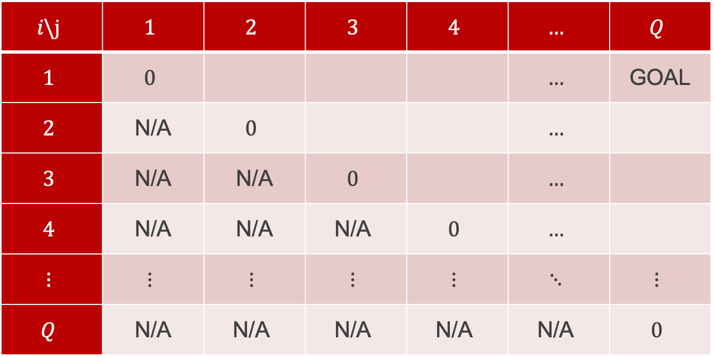
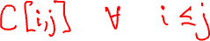
Defining a Data Structure
$$i\backslash j$$ | $$1$$ | $$2$$ | $$3$$ | $$4$$ | $$…$$ | $$Q$$
$$1$$ | $$0$$ |  |  |  | $$…$$ | GOAL
$$2$$ | N/A | $$0$$ |  |  | $$…$$
$$3$$ | N/A | N/A | $$0$$ |  | $$…$$
$$4$$ | N/A | N/A | $$\text{N}\text{/}\text{A}$$ | $$0$$ | $$…$$
$$⋮$$ | $$⋮$$ | $$⋮$$ | $$⋮$$ | $$⋮$$ | $$⋱$$ | $$⋮$$
$$Q$$ | N/A | $$\text{N}\text{/}\text{A}$$ | $$\text{N}\text{/}\text{A}$$ | $$\text{N}\text{/}\text{A}$$ | $$\text{N}\text{/}\text{A}$$ | $$0$$
$$C=$$

Slide 12
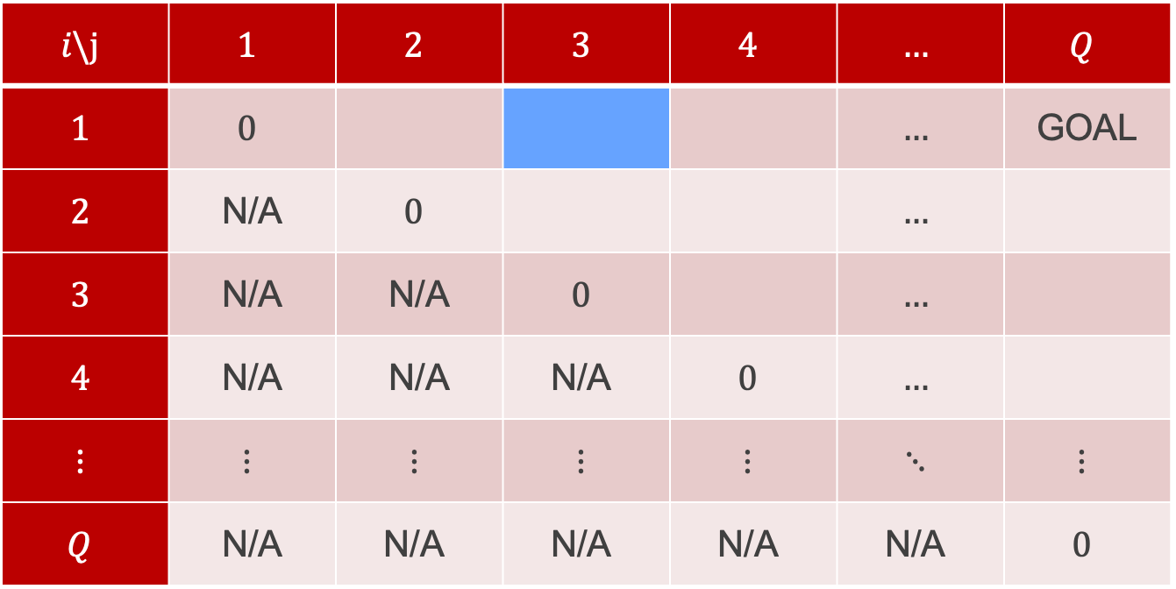
Defining a Data Structure
What is the best way to multiply $X_{1}X_{2}X_{3}$?
$$i\backslash j$$ | $$1$$ | $$2$$ | $$3$$ | $$4$$ | $$…$$ | $$Q$$
$$1$$ | $$0$$ |  |  |  | $$…$$ | GOAL
$$2$$ | N/A | $$0$$ |  |  | $$…$$
$$3$$ | N/A | N/A | $$0$$ |  | $$…$$
$$4$$ | N/A | N/A | $$\text{N}\text{/}\text{A}$$ | $$0$$ | $$…$$
$$⋮$$ | $$⋮$$ | $$⋮$$ | $$⋮$$ | $$⋮$$ | $$⋱$$ | $$⋮$$
$$Q$$ | N/A | $$\text{N}\text{/}\text{A}$$ | $$\text{N}\text{/}\text{A}$$ | $$\text{N}\text{/}\text{A}$$ | $$\text{N}\text{/}\text{A}$$ | $$0$$
$$C=$$

Slide 13
Defining a Data Structure
Either $\left(X_{1}X_{2}\right)X_{3}$ or $X_{1}\left(X_{2}X_{3}\right)$
$$i\backslash j$$ | $$1$$ | $$2$$ | $$3$$ | $$4$$ | $$…$$ | $$Q$$
$$1$$ | $$0$$ |  |  |  | $$…$$ | GOAL
$$2$$ | N/A | $$0$$ |  |  | $$…$$
$$3$$ | N/A | N/A | $$0$$ |  | $$…$$
$$4$$ | N/A | N/A | $$\text{N}\text{/}\text{A}$$ | $$0$$ | $$…$$
$$⋮$$ | $$⋮$$ | $$⋮$$ | $$⋮$$ | $$⋮$$ | $$⋱$$ | $$⋮$$
$$Q$$ | N/A | $$\text{N}\text{/}\text{A}$$ | $$\text{N}\text{/}\text{A}$$ | $$\text{N}\text{/}\text{A}$$ | $$\text{N}\text{/}\text{A}$$ | $$0$$
$$C=$$

Slide 14
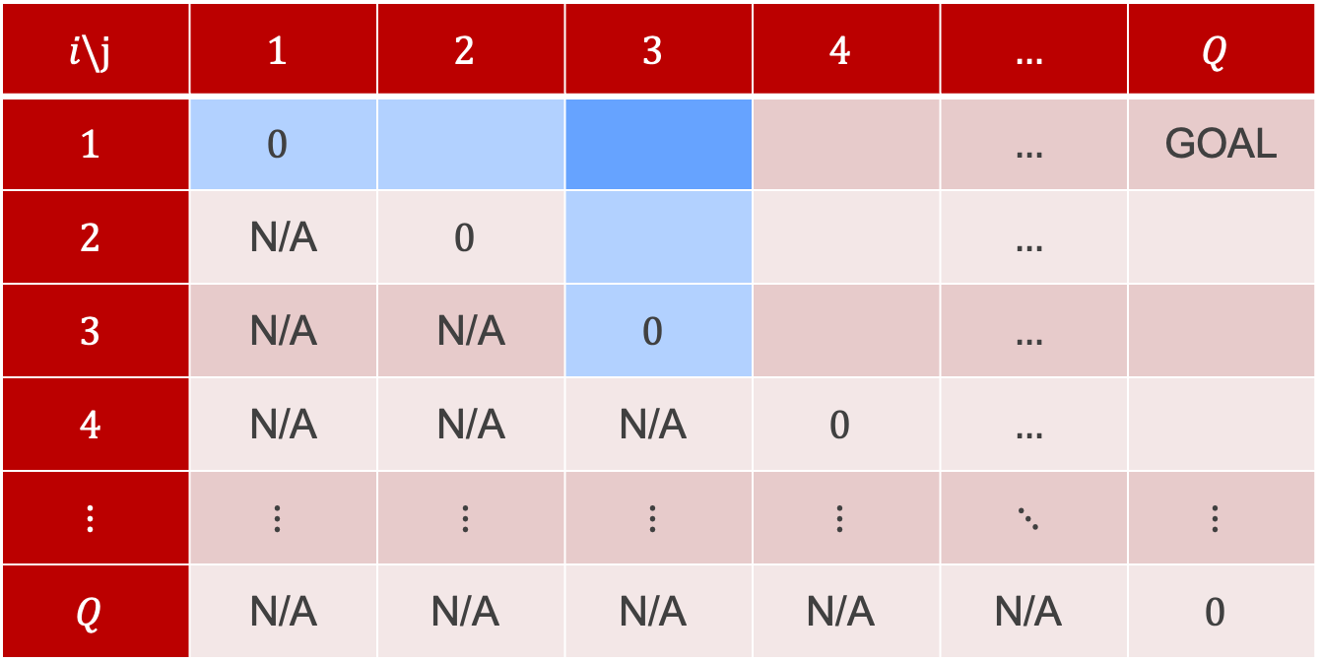
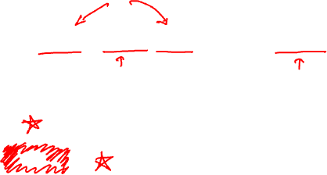
Defining a Data Structure
$$C\left[1, 3\right]=\min{(C\left[1,1\right]+C\left[2,3\right]+n_{1}n_{2}n_{4},C\left[1,2\right]+C\left[3,3\right]+n_{1}n_{3}n_{4}})$$
$$i\backslash j$$ | $$1$$ | $$2$$ | $$3$$ | $$4$$ | $$…$$ | $$Q$$
$$1$$ | $$0$$ |  |  |  | $$…$$ | GOAL
$$2$$ | N/A | $$0$$ |  |  | $$…$$
$$3$$ | N/A | N/A | $$0$$ |  | $$…$$
$$4$$ | N/A | N/A | $$\text{N}\text{/}\text{A}$$ | $$0$$ | $$…$$
$$⋮$$ | $$⋮$$ | $$⋮$$ | $$⋮$$ | $$⋮$$ | $$⋱$$ | $$⋮$$
$$Q$$ | N/A | $$\text{N}\text{/}\text{A}$$ | $$\text{N}\text{/}\text{A}$$ | $$\text{N}\text{/}\text{A}$$ | $$\text{N}\text{/}\text{A}$$ | $$0$$
$$C=$$

Slide 15
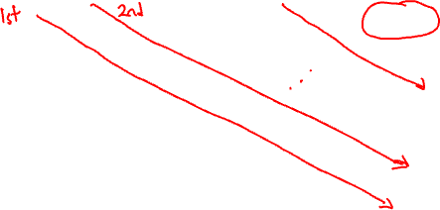
Defining a Data Structure
$$C\left[i,j\right]=\min_{k ∈ \left[i,j−1\right]}{(C\left[i,k\right]+C\left[k+1,j\right]}+n_{i}n_{k+1}n_{j+1})$$
$$i\backslash j$$ | $$1$$ | $$2$$ | $$3$$ | $$4$$ | $$…$$ | $$Q$$
$$1$$ | $$0$$ |  |  |  | $$…$$ | GOAL
$$2$$ | N/A | $$0$$ |  |  | $$…$$
$$3$$ | N/A | N/A | $$0$$ |  | $$…$$
$$4$$ | N/A | N/A | $$\text{N}\text{/}\text{A}$$ | $$0$$ | $$…$$
$$⋮$$ | $$⋮$$ | $$⋮$$ | $$⋮$$ | $$⋮$$ | $$⋱$$ | $$⋮$$
$$Q$$ | N/A | $$\text{N}\text{/}\text{A}$$ | $$\text{N}\text{/}\text{A}$$ | $$\text{N}\text{/}\text{A}$$ | $$\text{N}\text{/}\text{A}$$ | $$0$$
$$C=$$

Slide 16
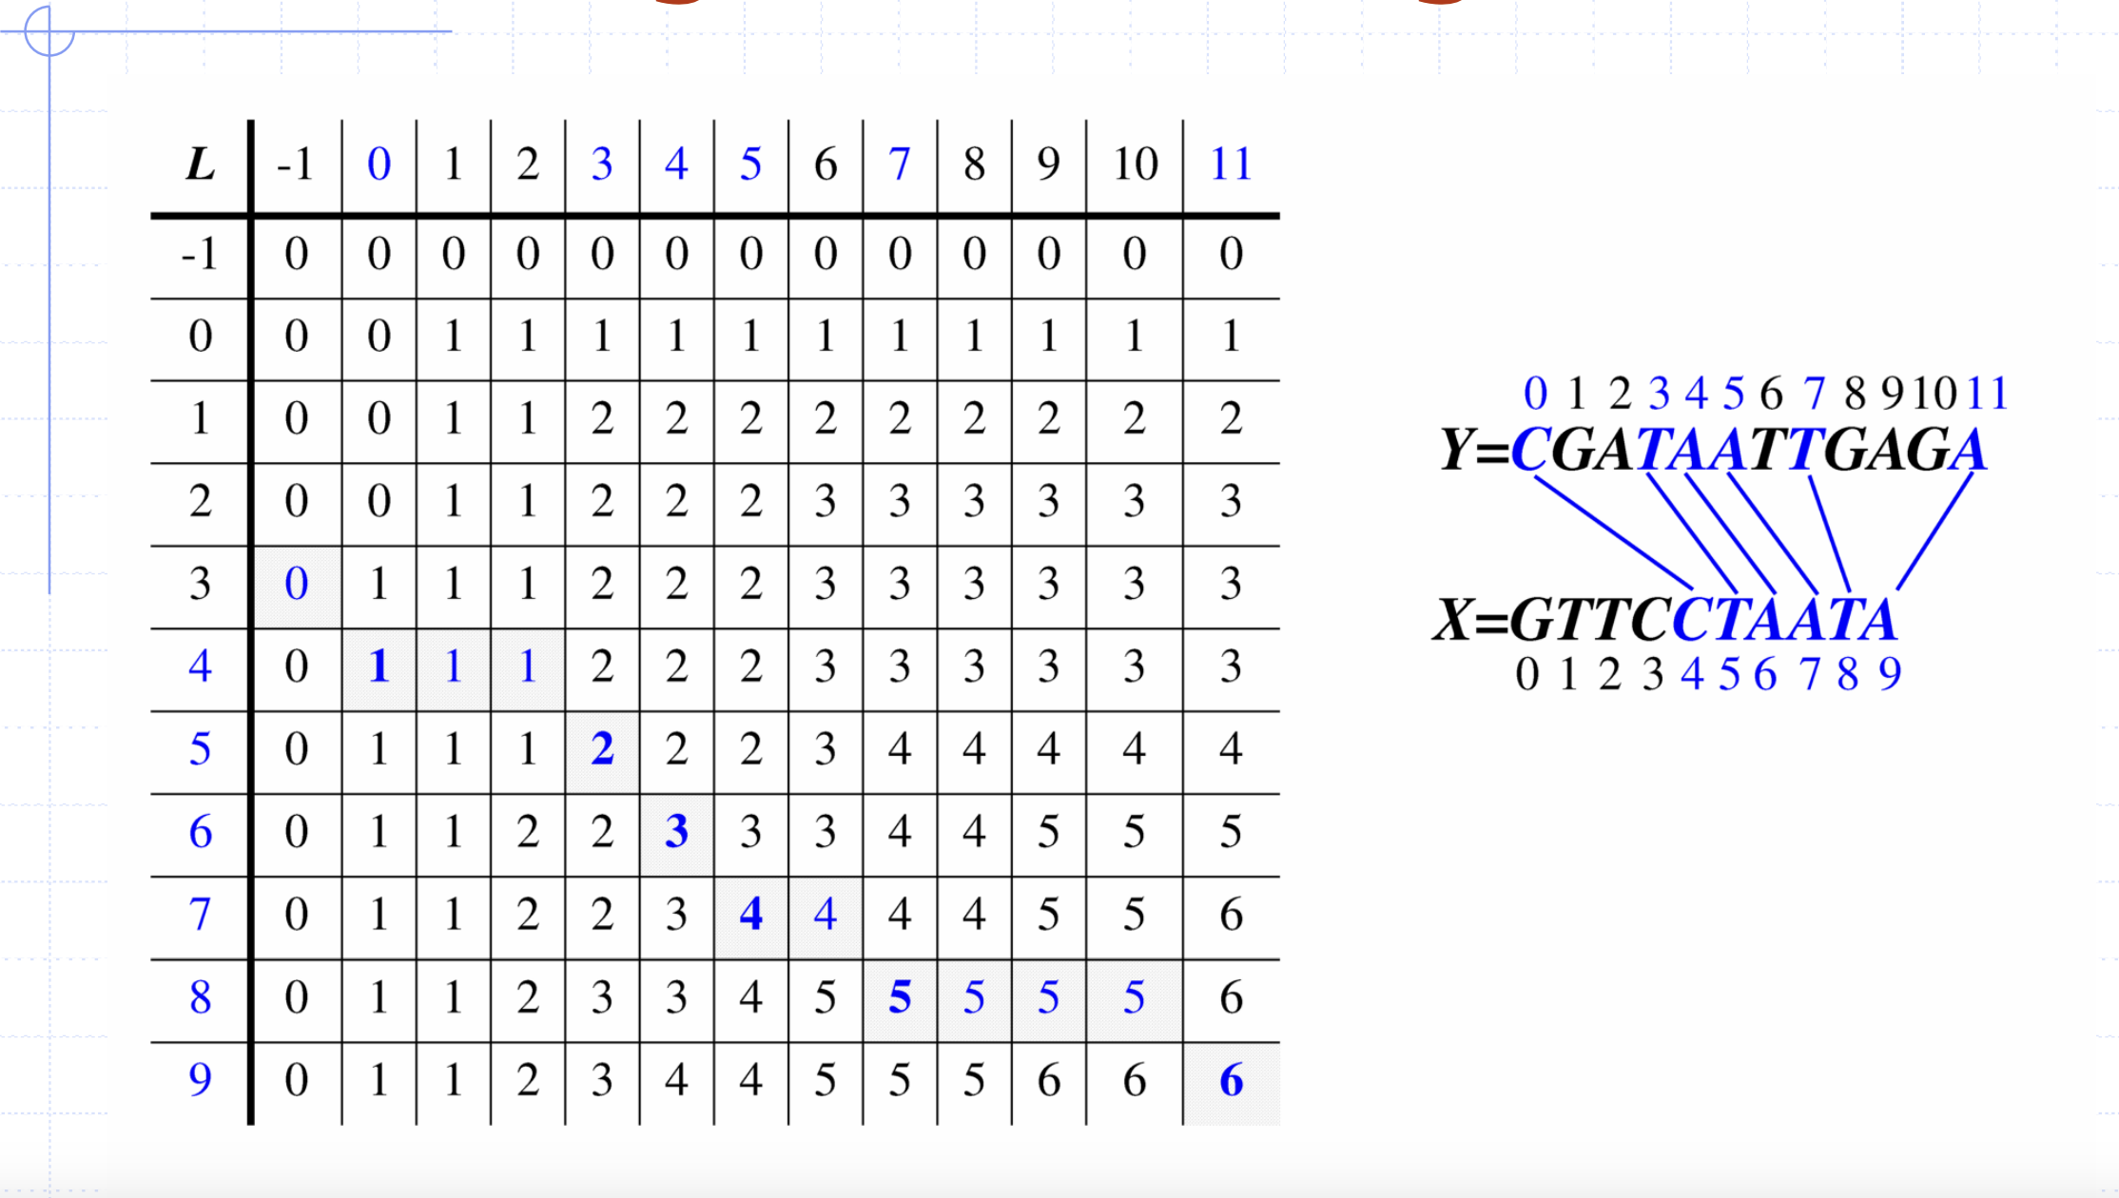
Longest common subsequence

Slide 17
Least common subsequence
0
1
2
3
4
5
6
7
8
9
10
11
CGATAATTGAGA
GTTCCTAATA
0
1
2
3
4
5
6
7
8
9

Slide 18
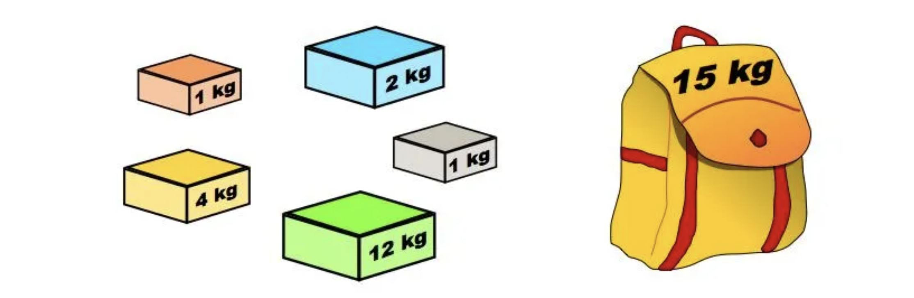
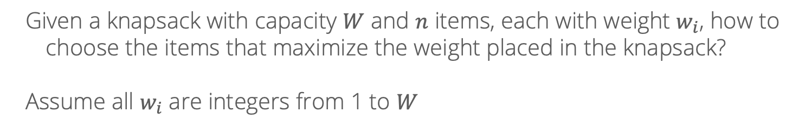
Knapsack problem
Given a knapsack with capacity $W$ and $n$ items, each with weight $w_{i}$, how to choose the items that maximize the weight placed in the knapsack?
Assume all $w_{i}$ are integers from 1 to $W$

Slide 19
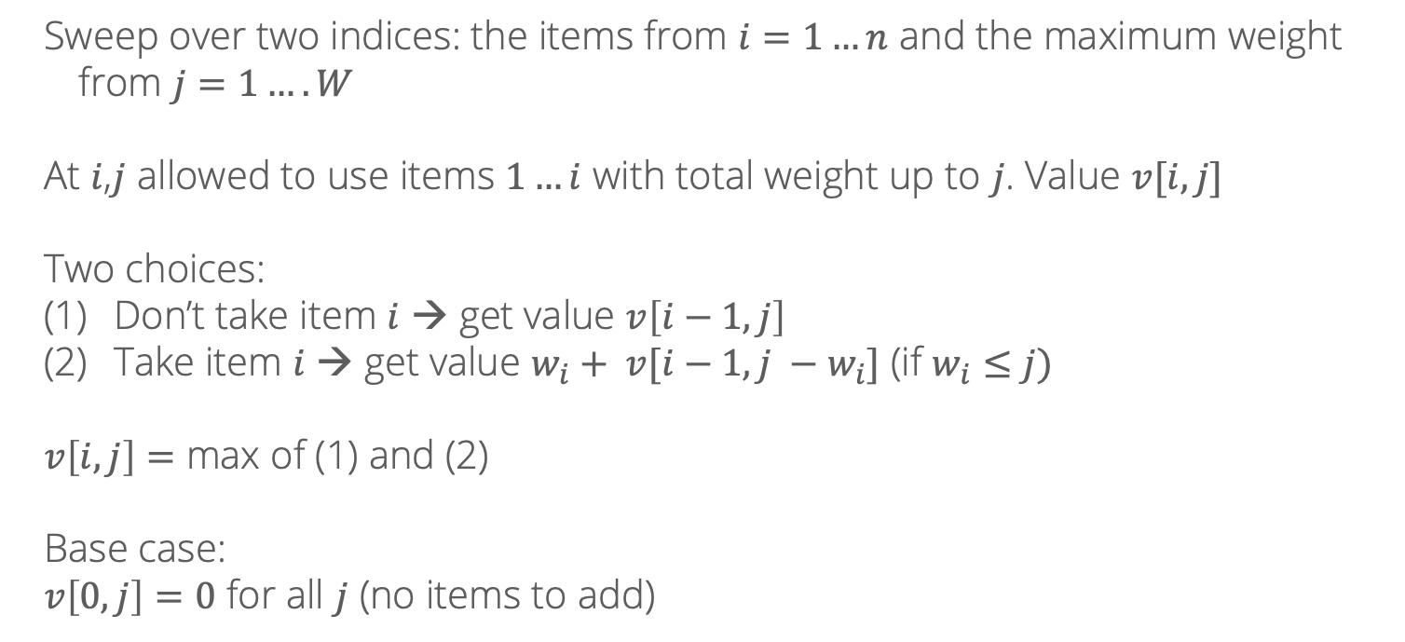
DP solution
Sweep over two indices: the items from $i=1…n$ and the maximum weight from $j=1….W$
At $i$,$j$ allowed to use items $1…i$ with total weight up to $j$. Value $v[i,j]$
Two choices:
Don’t take item $i$ → get value $v\left[i−1, j\right]$
Take item $i$ → get value $w_{i}+ v[i−1, j −w_{i}]$ (if $w_{i}≤j)$
$v\left[i,j\right]=$ max of (1) and (2)
Base case:
$v\left[0, j\right]=0$ for all $j$ (no items to add)

Slide 20
Rounding
What if the items don’t have integer weights?
0.5 kg
1.33 kg
9.843 kg
0.7 kg
2.78 kg
10.16 kg

Slide 21
Rounding
Idea: round weights up to the nearest 0.1 and the total capacity down
0.5 kg
1.4 kg
9.8 kg
0.7 kg
2.8 kg
10.2 kg

Slide 22
Rounding
Idea: round weights up to the nearest 0.1 and the total capacity down
5 kg
14 kg
98 kg
7 kg
28 kg
102 kg
Now, rescale everything by multiplying by 10

Slide 23
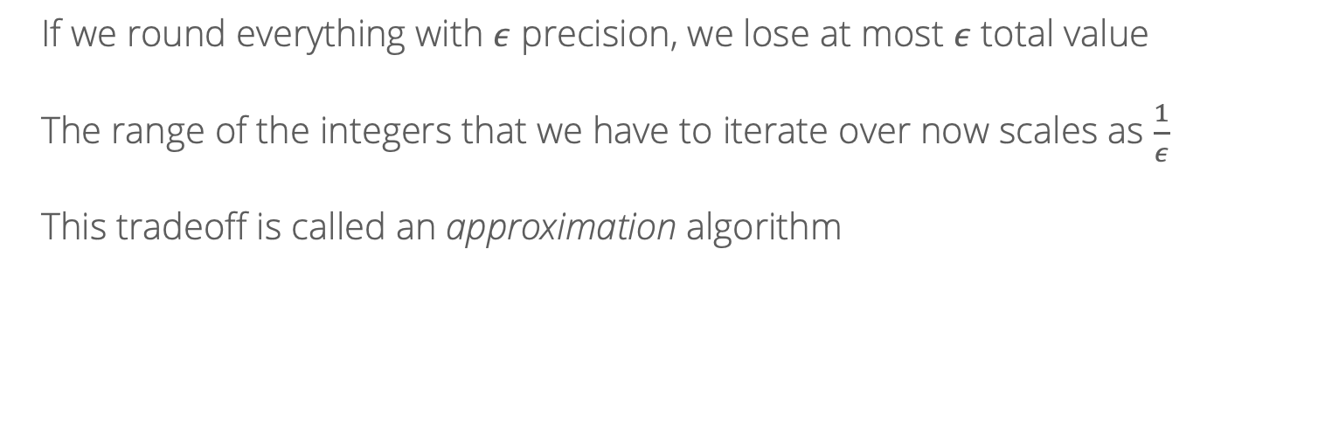
Rounding
If we round everything with $ε$ precision, we lose at most $ε$ total value
The range of the integers that we have to iterate over now scales as $\frac{1}{ε}$
This tradeoff is called an approximation algorithm

